Slide 1

Evaluation of high-matrix size CT reconstructions in peripheral artery disease
IDS 702 Final Project
F. R. Schwartz

Slide 2
Introduction
Peripheral artery disease (PAD) is common and often requires medical intervention^{1,2}
Radiology image quality often low
Could be improved with higher resolution³
¹Bevan GH; Evidence-Based Medical Management of Peripheral Artery Disease. Arteriosclerosis, Thrombosis and Vascular Biology 2020
²Tanaka R; Novel developments in non-invasive imaging of peripheral arterial disease with CT; Clin Radiol 2019
³Tsubamoto M; Ultra high-resolution computed tomography with 1024-matrix; Eur J Radiol 2020
Notes:
Possible disease=renal masses and stones

Slide 3
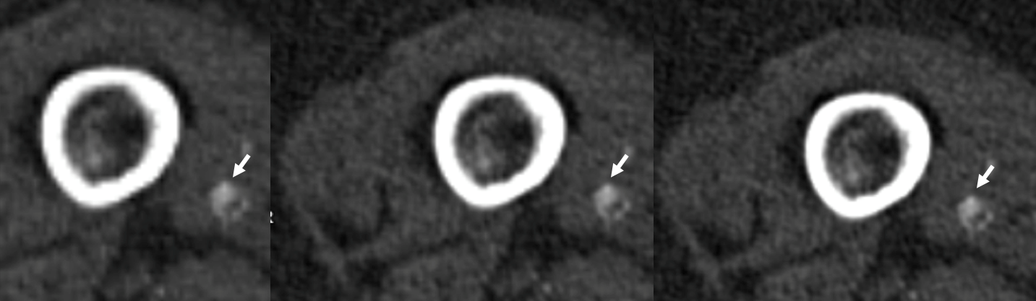
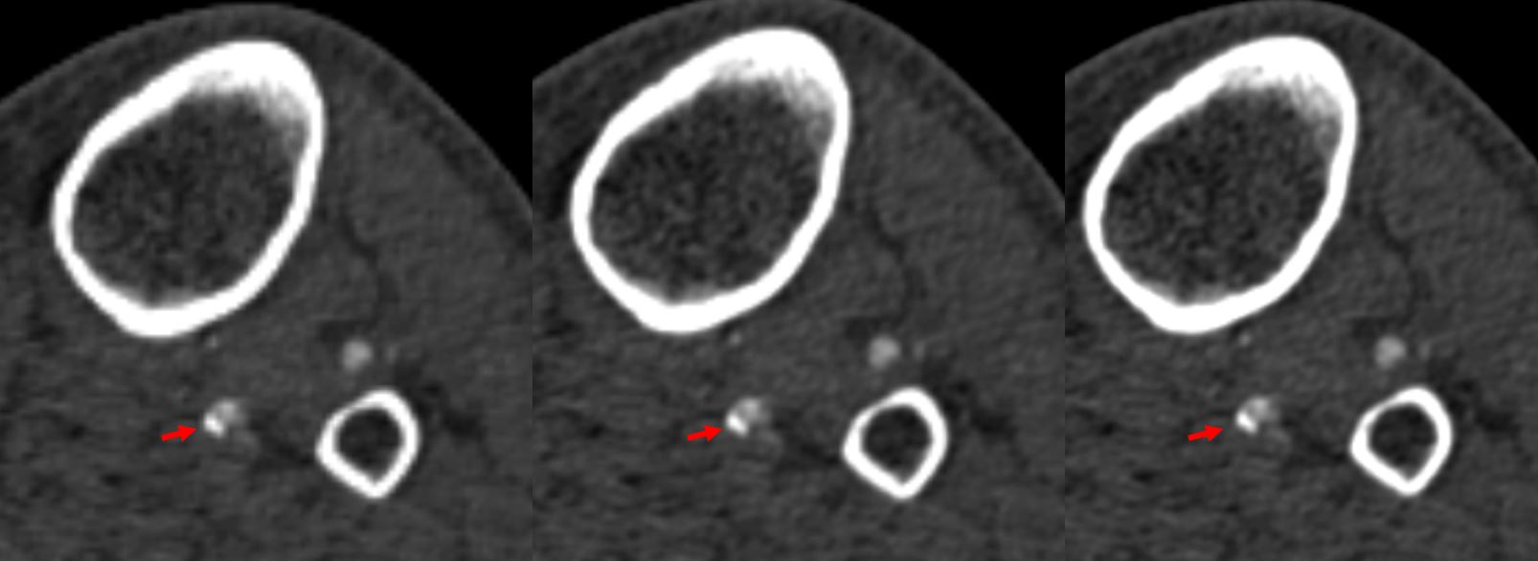
Examples
Femoral
512x512
768x768
1024x1024
Tibial
Notes:
Mean scores for perceived wall delineation, image noise and reader confidence in determining grade of stenosis with 95% Confidence Intervals for femoro-popliteal (fem-pop) segments and for tibial segments; *statistically significantly improved over 512x512 matrix size, † p=0.05

Slide 4
Hypothesis
Higher matrix sizes improve image quality over the current clinical standard of 512x512
Intemediate matrix size might produce high enough image quality for clinical practice

Slide 5
Questions of interest
Improvement of discernability of the vessel wall and diagnostic confidence?
Increase in perceived image noise?
Improvement between higher matrices?

Slide 6
Methods

Slide 7
Data
50 consecutive lower extremity CTA
Recons at 512x512, 768x768 and 1024x1024 matrices
5 blinded readers graded 150 images in randomized order:
Vascular wall definition
Image noise
Confidence in determination of stenosis grade

Slide 8
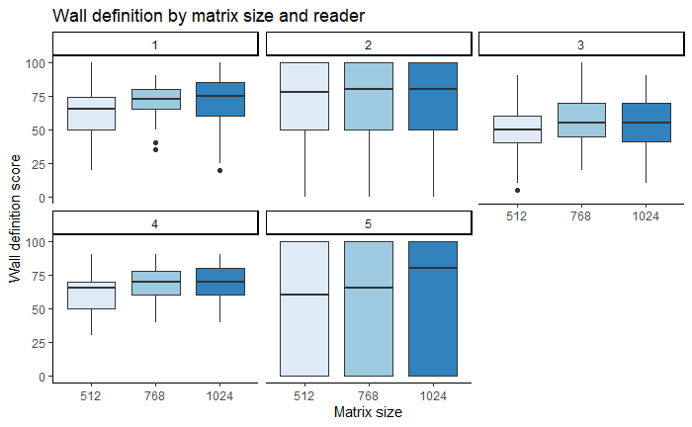
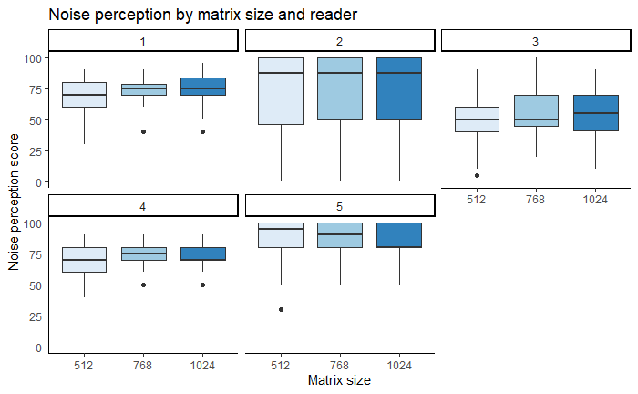
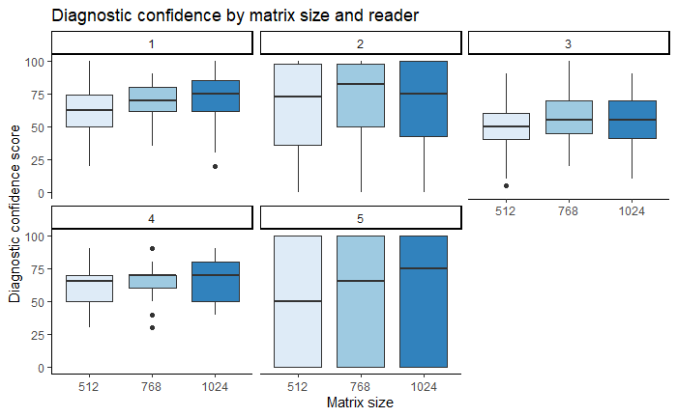
EDA
Notes:
Reader 1,4 and 5 are diagnostic radiologists
Reader 2 is a vascular surgeon
Reader 3 is an interventional radiologist

Slide 9
Models
Testing:
Regular linear model with reader and patient treated as factor variables
Mixed linear effects model
matrix size as fixed effect
reader and patient as random effects
Mixed linear effects model
matrix size as fixed effect
reader and patient as random effects
random slopes for matrix by reader

Slide 10
Models
Comparing models with Chi² using AIC
Standard linear model: 7718.8
LMER without random slopes: 6931.4
LMER with random slopes: 6943.2
10.2%
0.2%
Notes:
AIC is lower for the linear mixed effects model without (6931.4) and with random slopes (6943.2) for matrix by reader than for the standard linear model (7118.8). In addition to the AIC, the BIC is lower for the model without random slopes (6959.2) than for the one with random slopes (6998.6). Thus, random slopes will not be added to the final model (model 2).

Slide 11
Results

Slide 12
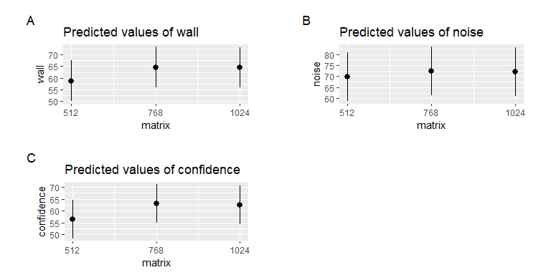
Predictions
Notes:
AIC is lower for the linear mixed effects model without (6931.4) and with random slopes (6943.2) for matrix by reader than for the standard linear model (7118.8). In addition to the AIC, the BIC is lower for the model without random slopes (6959.2) than for the one with random slopes (6998.6). Thus, random slopes will not be added to the final model (model 2).

Slide 13
Reader scores
 | 512x512 femoral | 768x768 femoral | 1024x1024 femoral | 512x512 tibial | 768x768 tibial | 1024x1024 tibial
Wall delineation | 78 [69-87] | 78 [69-87] | 83† [74-92] | 51 [41-61] | 59* [49-69] | 57* [47-67]
Image noise | 81 [71-91] | 81 [71-91] | 84 [74-93] | 65 [53-78] | 69 [56-82] | 68 [55-80]
Confidence stenosis grading | 76 [67-85] | 77 [68-86] | 81 [72-90] | 47 [38-57] | 56* [46-65] | 55* [45-65]
Notes:
Mean scores for perceived wall delineation, image noise and reader confidence in determining grade of stenosis with 95% Confidence Intervals for femoro-popliteal (fem-pop) segments and for tibial segments; *statistically significantly improved over 512x512 matrix size, † p=0.05

Slide 14
Results
Recons at higher matrix sizes ranked significantly better for:
Wall delineation
Confidence in determination of stenosis grade
No significant difference for image noise

Slide 15
Discussion

Slide 16
Limitations
Single center
Limited number of patients

Slide 17
Conclusions
Higher matrix reconstructions improve image quality with
Better wall delineation
More confident assessment of PAD
Intermediate and highest matrix sizes received similar scores

Slide 18
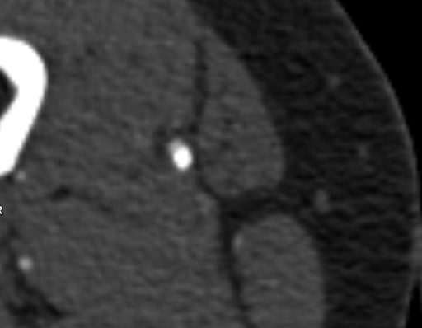
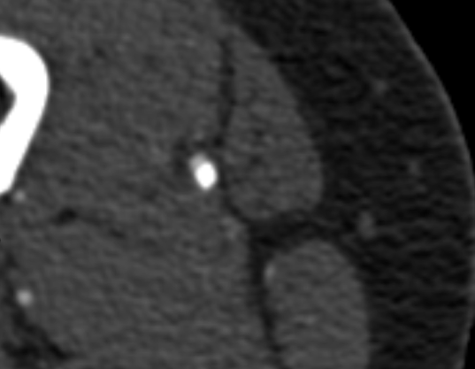
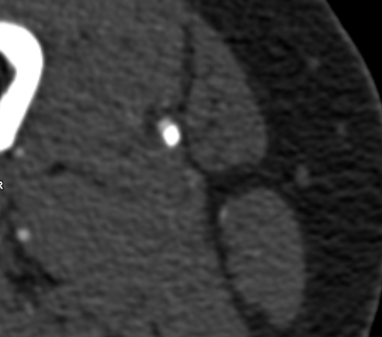
Thank you!
Fides.Schwartz@duke.edu

